Slide 1
Link State Routing

Slide 2
Protocol maintains complete road map of the network in each router running a link state routing protocol.
The node can use Dijkstra’s Algorithm to build routing table.
Look at the following slide - each node uses the same topology to create a routing table.

Slide 3
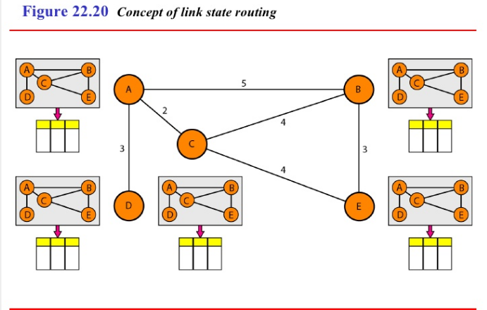

Slide 4
The topology must be dynamic, representing the latest state of each node and each link.
If there are changes in any point in the network, the topology must be updated for each node.
No node can know the topology at the beginning or after a change somewhere in the network.
Link state routing is based on the assumption that, although the global knowledge about the topology is not clear, each node has a partial knowledge - (type, condition and cost) - of its link.
Next figure indicate the part of the knowledge belonging to each node.

Slide 5
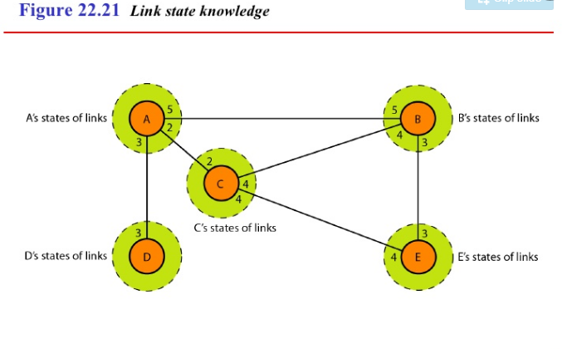

Slide 6
Building routing table
4 set of actions are required to ensure that each node has the routing table showing the least–cost node to every other node.
Creation of the states of the links by each node, called Link state packet (LSP).
Dissemination of LSPs to every other node, called flooding.
Formation of shortest path tree for each node.
Calculation of a routing table based on the shortest path tree.

Slide 7
1. Creation of Link State Packet (LSP)
A LSP can carry a large amount of information.
Like node id, the list of links, a sequence number, age
First two are needed to make the topology.
Sequence number - facilitates flooding and distinguishes the new LSPs from old ones.
Age - prevents old LSPs from remaining in the domain for a long time.
LSPs are generated on two occasions:
When there is a change in the topology of the domain
On a periodic basis

Slide 8
2. Flooding of LSPs
After a node has prepared an LSP, it must be disseminated to all other nodes, not only its neighbors. The process is called flooding.
Steps
The creating node sends a copy of the LSP out of each interface.
A node that receives an LSP compares it with the copy it may already have, if arrived LSP older than the one it has (by checking the sequence no), it discard the packet.
If it is newer.
Discards the old one and keep the new one.
It sends a copy of it out of each interface except the one from which the packet arrived.

Slide 9
3. Formation of shortest path tree
After receiving all LSPs, each node will have a copy of the whole topology.
This is not sufficient to find the shortest path to every other node.
A shortest path tree is needed.
The Dijkstra’s algorithm creates a shortest path tree from a graph.
The algorithm divides the node into two sets: tentative and permanent.
It finds the neighbors of a current node ,makes them tentative, examine them if passes criteria, make them permanent.

Slide 10
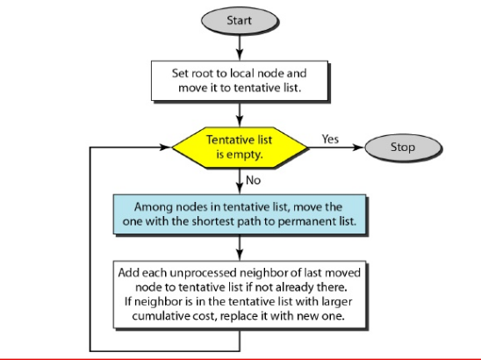
Dijkstra’s algorithm

Slide 11
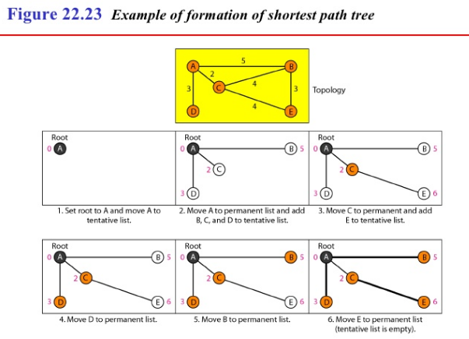

Slide 12
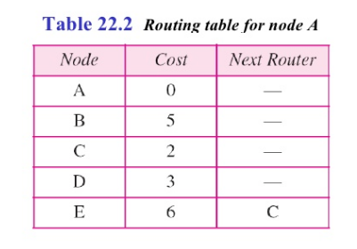
4. Calculation of routing table from Shortest Path tree
Each node uses the shortest path tree protocol to construct its routing table.
The routing table shows the cost of reaching each node to root.

Slide 13
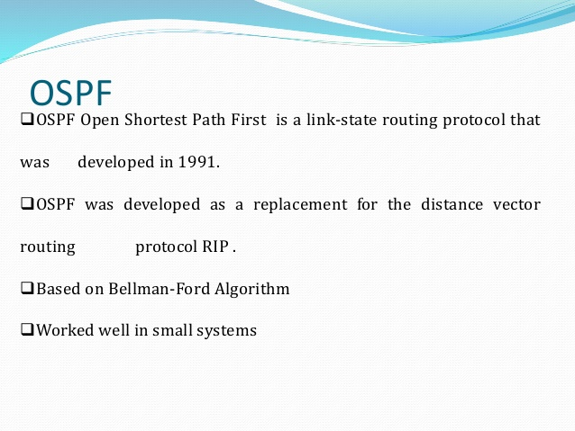

Slide 14
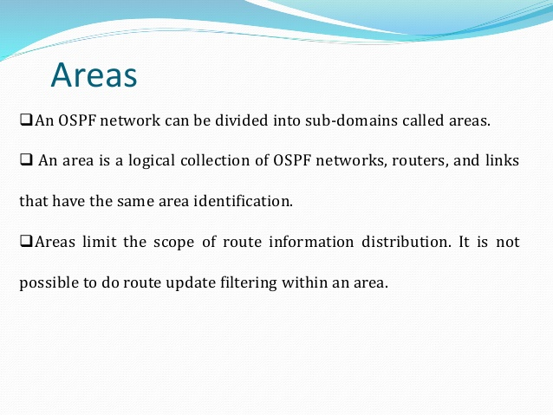

Slide 15
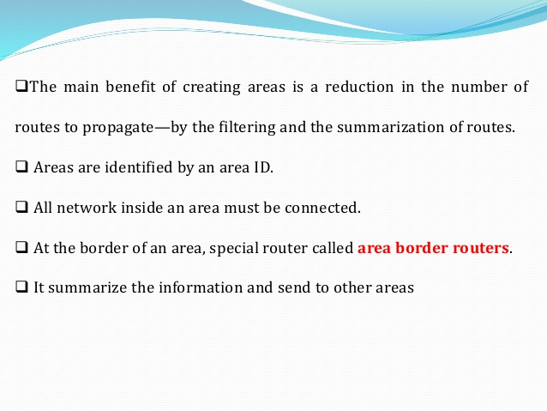

Slide 16
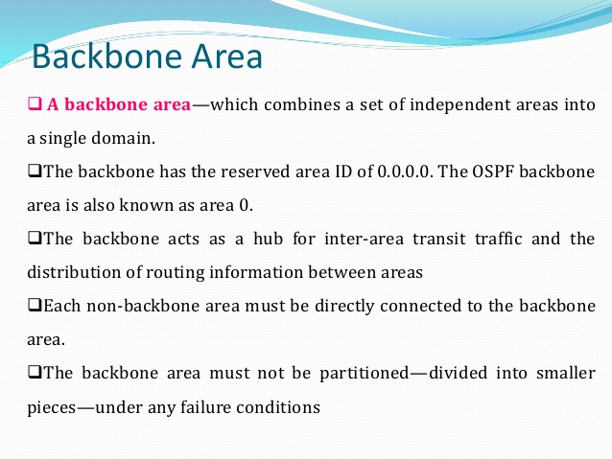

Slide 17
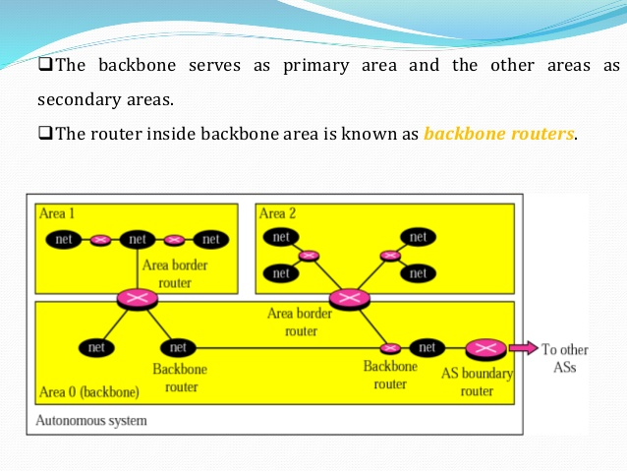

Slide 18
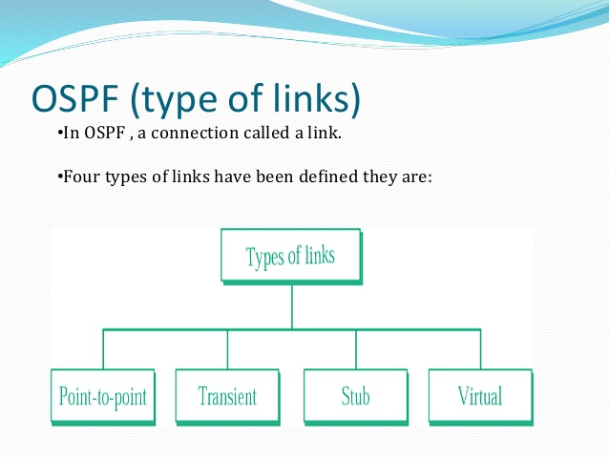

Slide 19
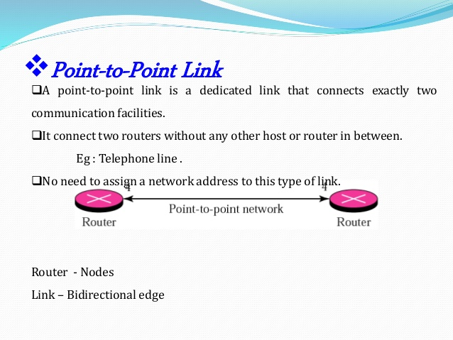

Slide 20
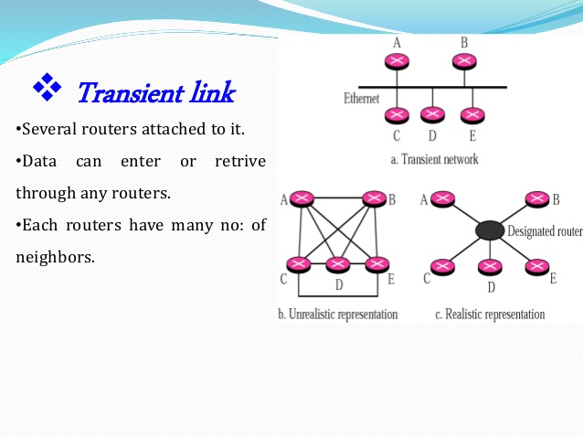

Slide 21
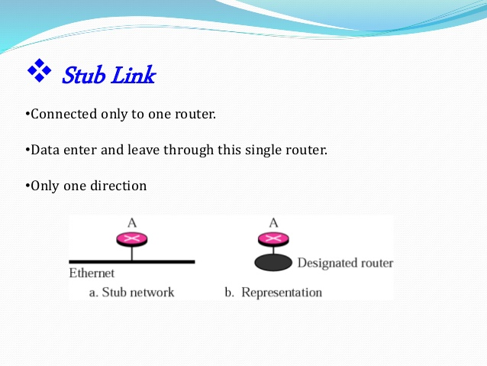

Slide 22
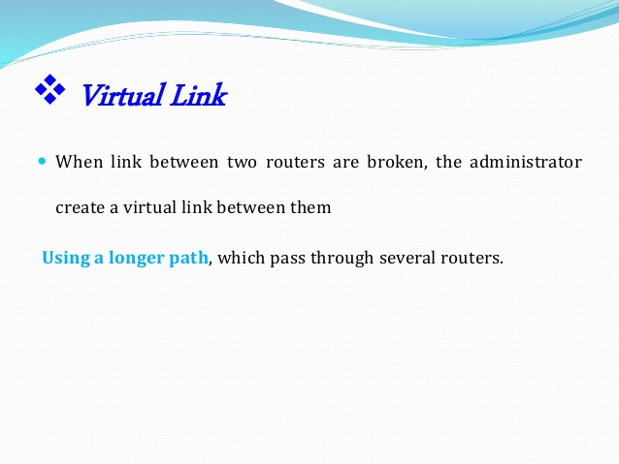

Slide 23
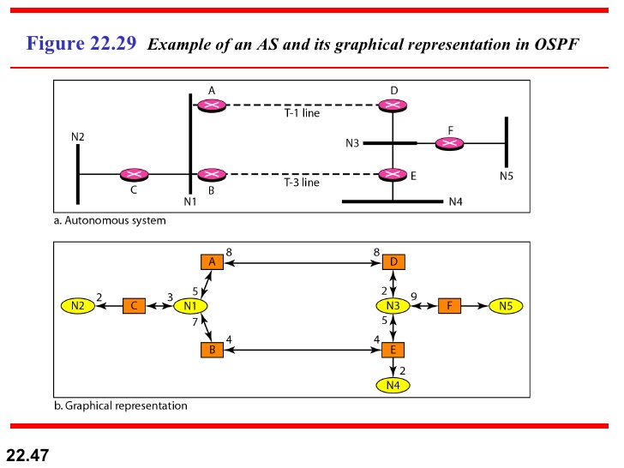
Graphical representation of AS

Slide 24
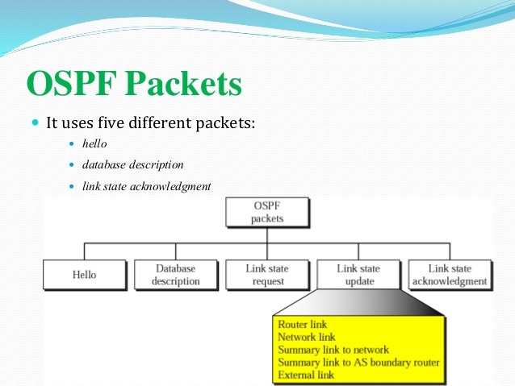

Slide 25
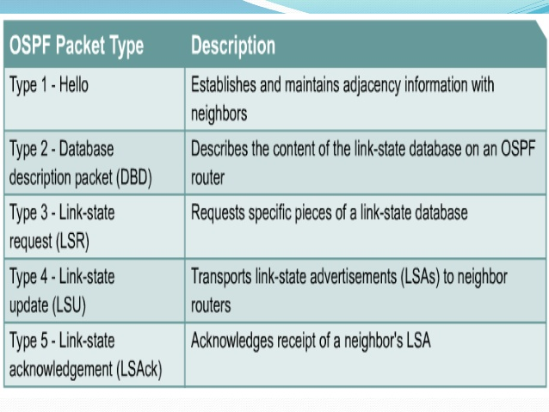

Slide 26
